Slide 1

Università degli Studi di Padova Dipartimento di Matematica "Tullio Levi-Civita"
Laurea Magistrale in Informatica
a.a. 2018-2019
FAST MESSAGE PROPAGATION OVER IOV SCENARIOS
Relatore: Prof. Claudio Enrico Palazzi
Co-relatore: Dott. Armir Bujari
Jordan Gottardo 1179739
Esame di laurea - 18 Luglio 2019
1

Slide 2
CONTENTS
Context
Simulations
Conclusions
Context
Technologies
Scenarios
Algorithm extension
Conclusion
State of the art
My contributions
Metrics
Simulation results
Future work
2

Slide 3

CONTEXT
Vehicular and Flying Ad-Hoc Networks (VANETs and FANETs)
Several applications
Smart city management
Video streaming
Traffic control
Focus: Emergency Message Distribution (EMD)
Message delivery
Timeliness
Avoid medium saturation
3

Slide 4




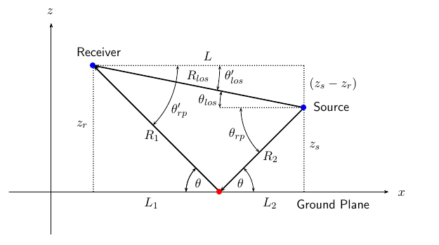
TECHNOLOGIES AND TOOLS
Expensive large scale tests
Need to use simulators (ns-3)
Additional tools and models
Real map data
Road junction modeling
Signal propagation models
Two-Ray Ground
Obstacle shadowing (with 3D extension)
4

Slide 5


ALGORITHM CLASSIFICATION
Multi-hop propagation
Farthest forwarder definition
Several approaches
Multi-hop algorithms
- Reliability
- End to end delay
- Reliability
+ End to end delay
Probabilistic
Deterministic
4

Slide 6

FAST-BROADCAST
Multi-hop probabilistic delay-based broadcasting protocol
Dynamic transmission range estimation
No need to know it a priori, as often assumed in other protocols
Estimation Phase:
Vehicles exchange small Hello Messages (beacons) to estimate their transmission range
1 Hello Message sent every BeaconInterval (e.g., 100ms) within each transmission range
Broadcast Phase:
A
B
C
D
Waiting time | [0…1024] | [0…512] | [0…32]
5

Slide 7
ROFF (RObust Fast Forwarding)
Multi-hop deterministic delay-based broadcasting protocol
Estimation Phase:
Each vehicle sends a Hello Message every BeaconInterval (e.g., 100ms)
Neighborhood discovery process
Each vehicle builds a Neighbor Table (NBT) with one entry for each neighbor
Broadcast Phase:
A
B
C
D
Priority | 3 | 2 | 1
Waiting time | 2 | 1 | 0
6

Slide 8

MY CONTRIBUTIONS
Improvements to Fast-Broadcast
Implementation and extension to 2D and 3D scenarios of ROFF
Evaluation and comparison of Fast-Broadcast and ROFF through simulations
Urban scenarios with and without buildings
Proposal of extension to exploit road junctions to increase message delivery ratios
SJ-Fast-Broadcast and SJ-ROFF (SJ=Smart Junction)
7

Slide 9


SIMULATIONS – SCENARIOS AND METRICS
Several scenarios of increasing complexity and realism
Metrics:
Coverage ↑
End-to-end delay ↓
Redundancy ↓
Scenario name | Type | Buildings | Drones
Platoon | 1D
Grid | 2D
Los Angeles | 2D
Padua | 2D
Los Angeles smart city | 3D
8

Slide 10
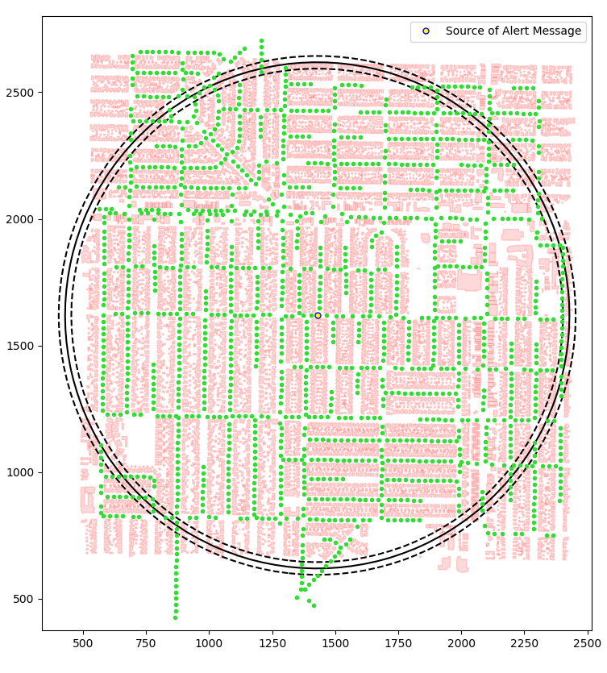
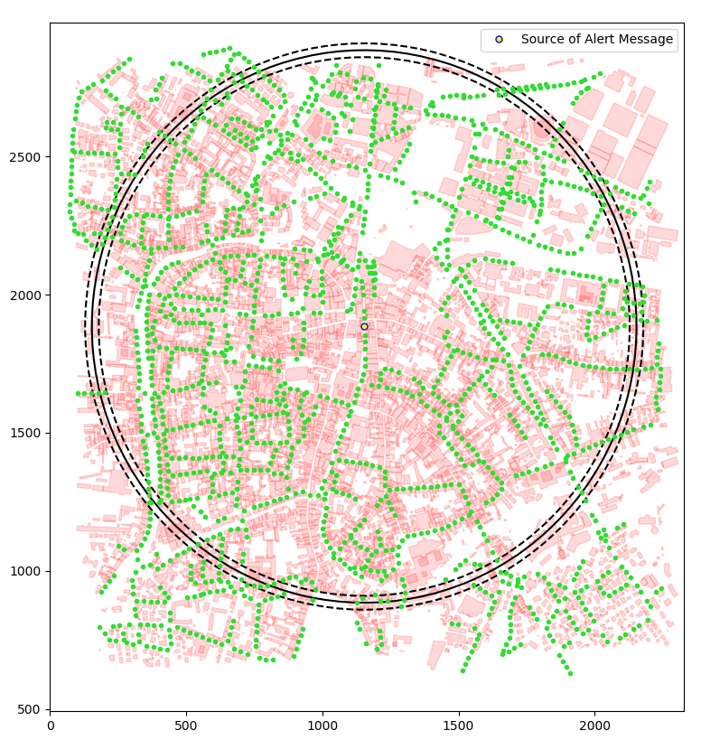
URBAN SCENARIOS
Los Angeles
Padua
9

Slide 11
PRELIMINARY TESTS - CONFIGURATION
Scenario configuration
Scenario name | Padua
Latitude N [°] | 45.4171
Latitude S [°] | 45.3981
Longitude W [°] | 11.8654
Longitude E [°] | 11.8923
Circumference radius [m] | 1000
Distance between vehicles [m] | 5, 15, 25, 35, 45
Number of vehicles | 4975, 2856, 1775, 1318, 1072
Number of simulations | 4500
Simulator configuration
Packet payload size | 100 byte
Frequency [GHz] | 2.4
Channel bandwidth [MHz] | 22
Transmission speed [Mbps] | 11
Transmission powers [dBm] | -7.0, 4.6, 13.4
Transmission ranges [m] | 100, 300, 500
Modulation | DSSS
Propagation loss model | ns3::TwoRayGround
Propagation delay model | ns3::ConstantSpeed
10

Slide 12
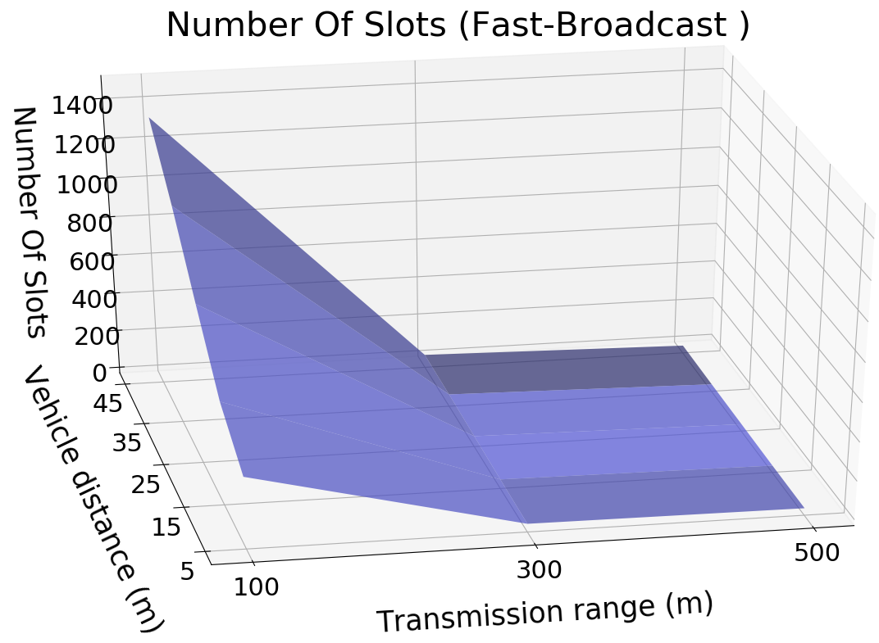
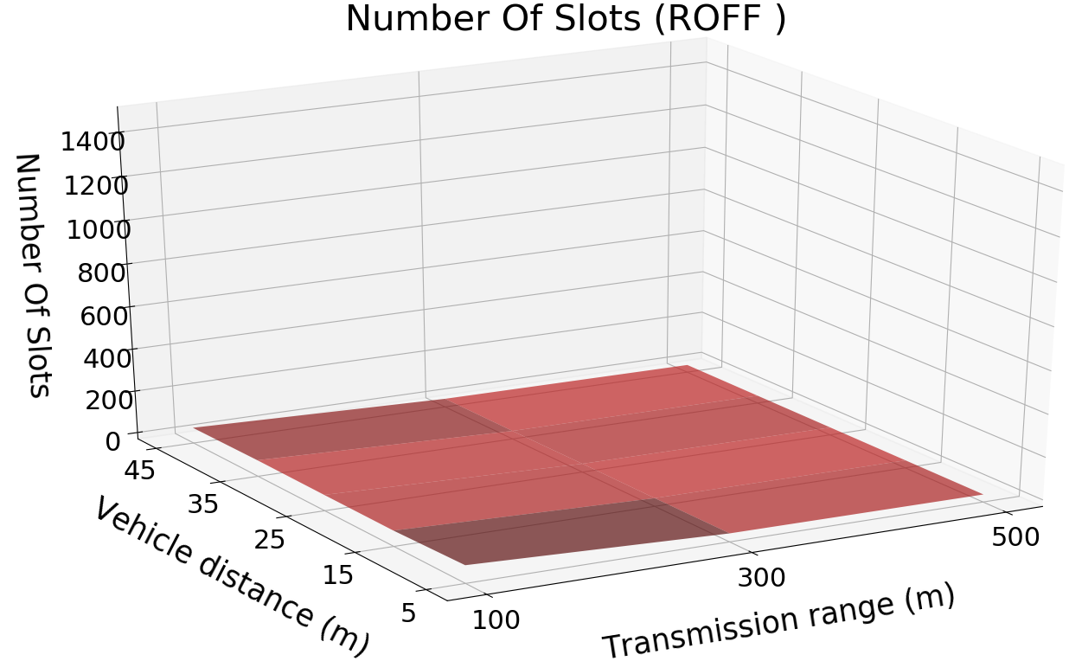
END-TO-END DELAY ↓
Coverage ↑ : comparable results
End-to-end delay ↓ :
11

Slide 13
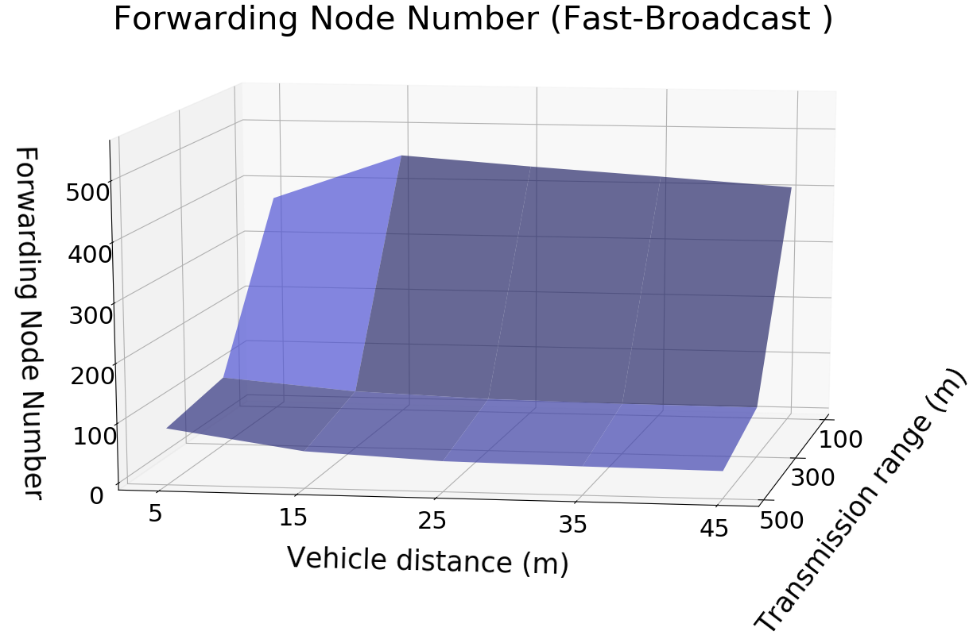
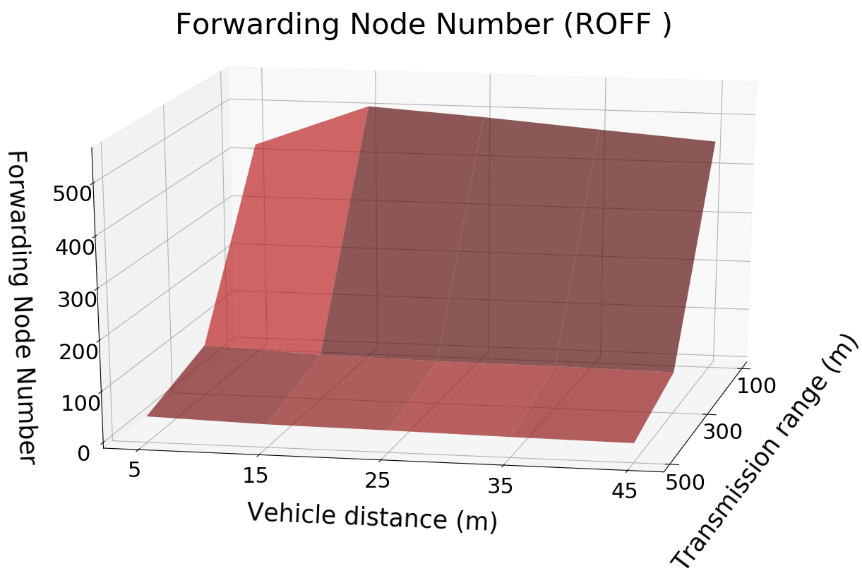
REDUNDANCY ↓
12

Slide 14
PADUA URBAN SCENARIO
Scenario configuration
Scenario name | Padua
Latitude N [°] | 45.4171
Latitude S [°] | 45.3981
Longitude W [°] | 11.8654
Longitude E [°] | 11.8923
Circumference radius [m] | 1000
Distance between vehicles [m] | 25
Number of vehicles | 1775
Number of buildings | 6322
Number of simulations | 4500
Simulator configuration
Packet payload size | 100 byte
Frequency [GHz] | 2.4
Channel bandwidth [MHz] | 22
Transmission speed [Mbps] | 11
Transmission powers [dBm] | -7.0, 4.6, 13.4
Transmission ranges [m] | 100, 300, 500
Modulation | DSSS
Propagation loss model | ns3::TwoRayGround
Propagation delay model | ns3::ConstantSpeed
Shadowing model | ns3::ObstacleShadowing
13

Slide 15
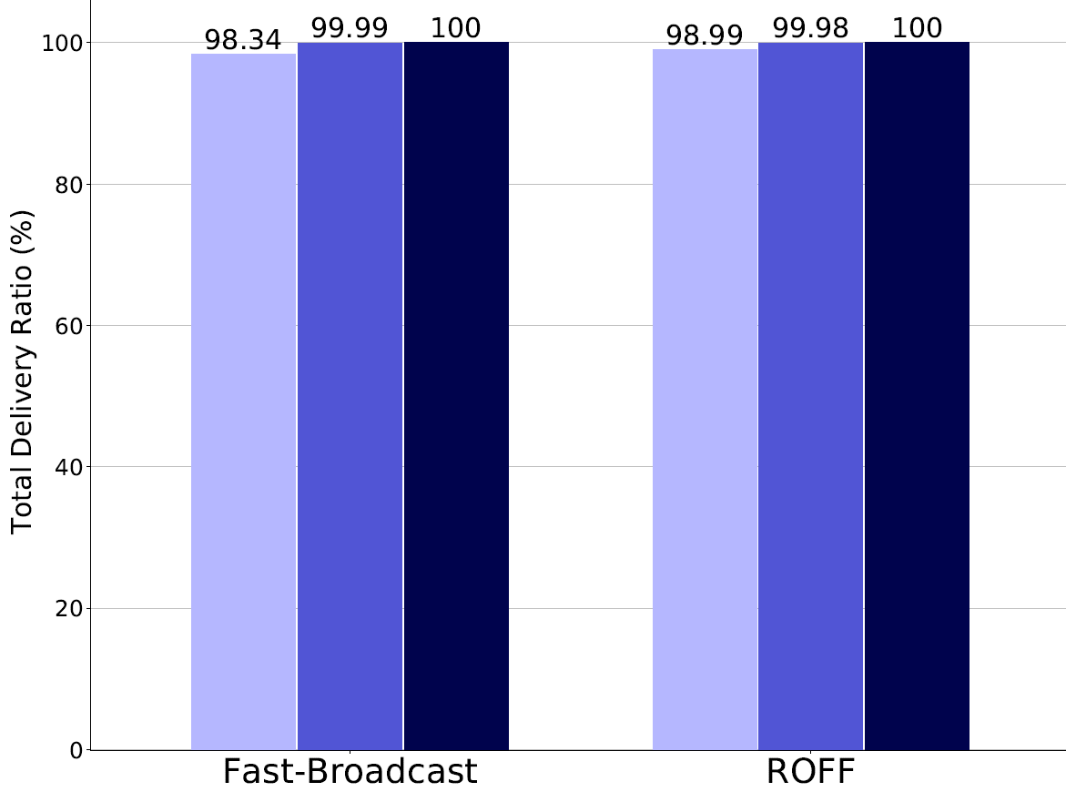
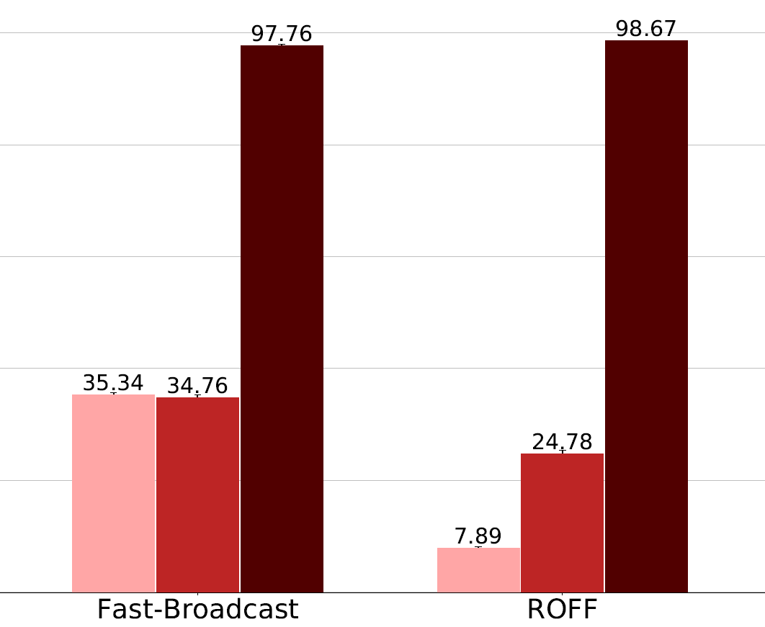






PADUA – COVERAGE ↑
Without buildings
With buildings
14

Slide 16
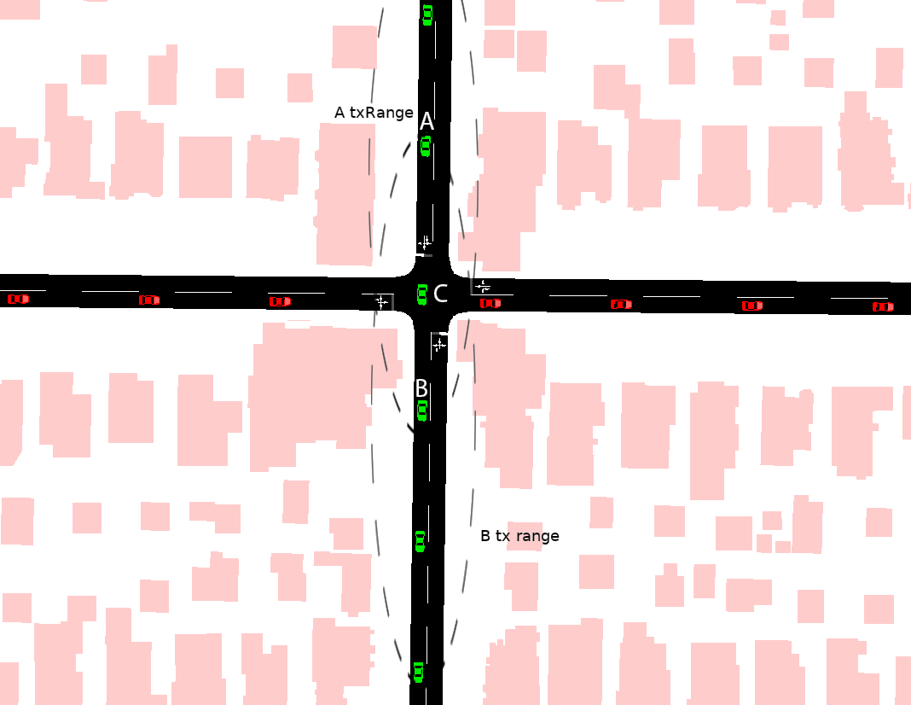
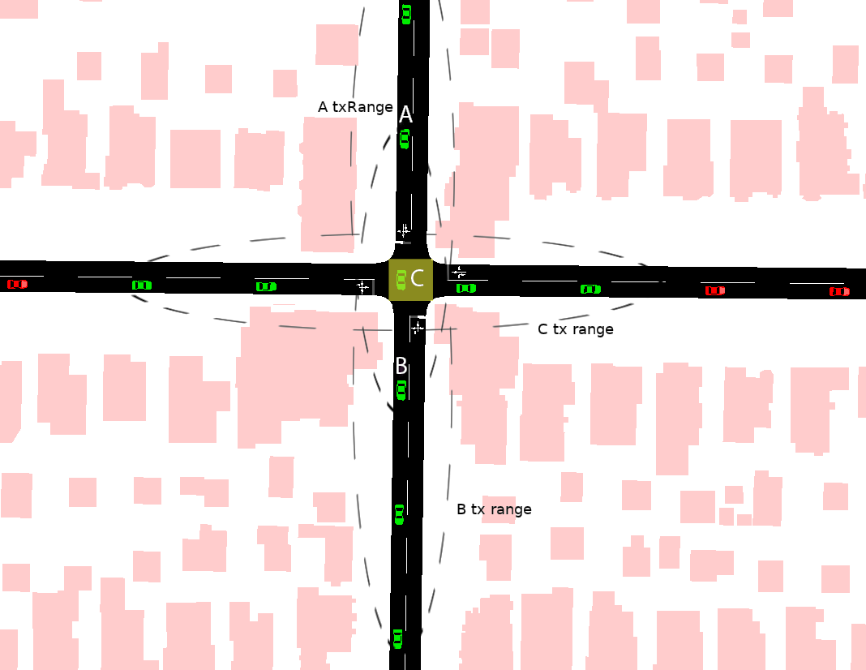
EXPLOITING JUNCTIONS – EXAMPLE
Without junction model
With junction model
15

Slide 17
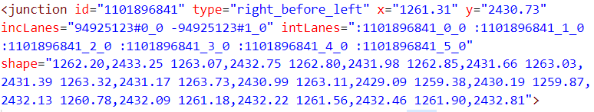
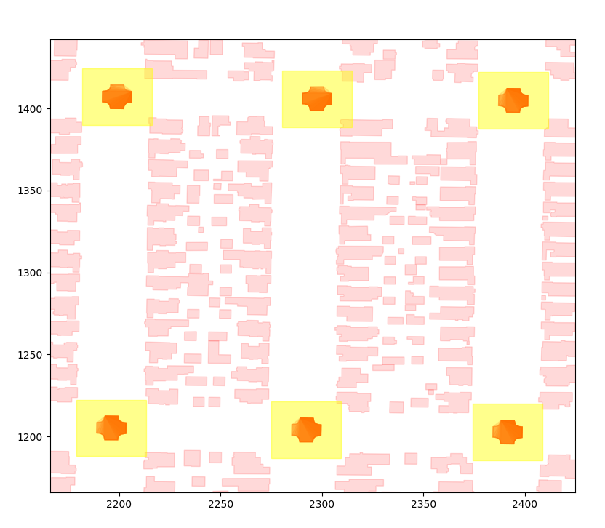
JUNCTION MODEL
Aim: exploit vehicles located within junctions to improve coverage
Identification of junctions via OSM/SUMO tools
20x20m bounding box to extend the polygon
Vehicles within a junction participate in a second contention with other vehicles within the same junction
Extension applicable both to Fast-Broadcast and ROFF
SJ-Fast-Broadcast and SJ-ROFF
16

Slide 18
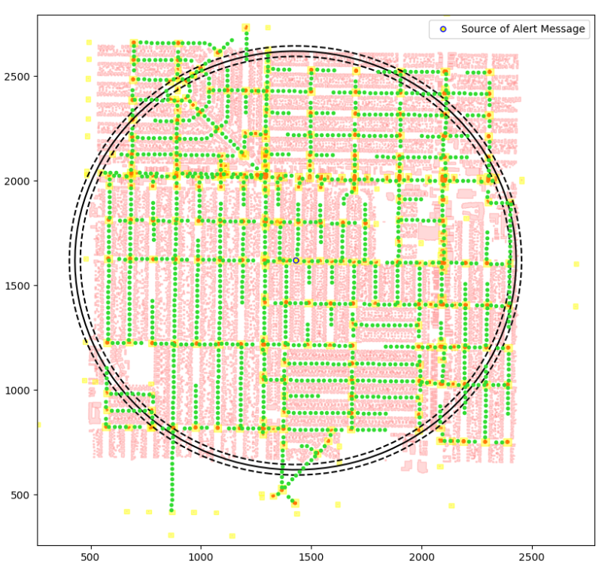
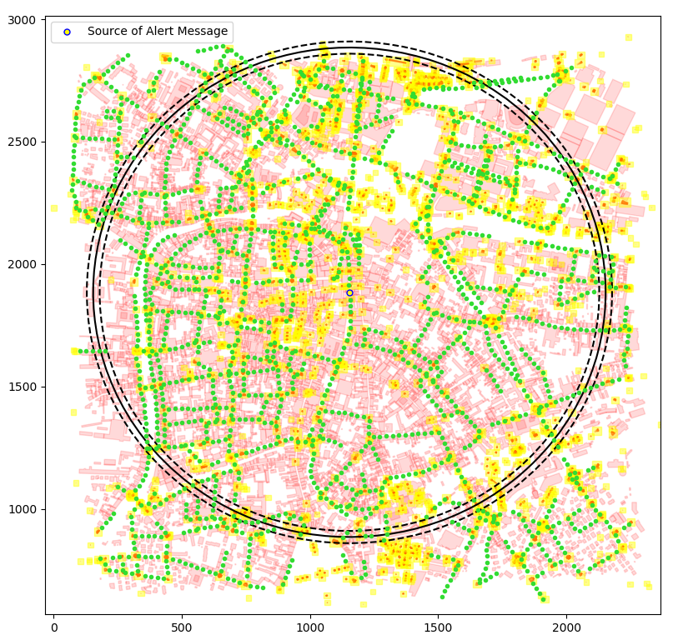
JUNCTION MODEL - SCENARIOS
Los Angeles
Padua
17

Slide 19
PADUA URBAN SCENARIO WITH JUNCTIONS
Scenario configuration
Scenario name | Padua
Latitude N [°] | 45.4171
Latitude S [°] | 45.3981
Longitude W [°] | 11.8654
Longitude E [°] | 11.8923
Circumference radius [m] | 1000
Distance between vehicles [m] | 25
Number of vehicles | 1775
Number of buildings | 6322
Number of junctions | 3231
Number of simulations | 4500
Simulator configuration
Packet payload size | 100 byte
Frequency [GHz] | 2.4
Channel bandwidth [MHz] | 22
Transmission speed [Mbps] | 11
Transmission powers [dBm] | -7.0, 4.6, 13.4
Transmission ranges [m] | 100, 300, 500
Modulation | DSSS
Propagation loss model | ns3::TwoRayGround
Propagation delay model | ns3::ConstantSpeed
Shadowing model | ns3::ObstacleShadowing
18

Slide 20
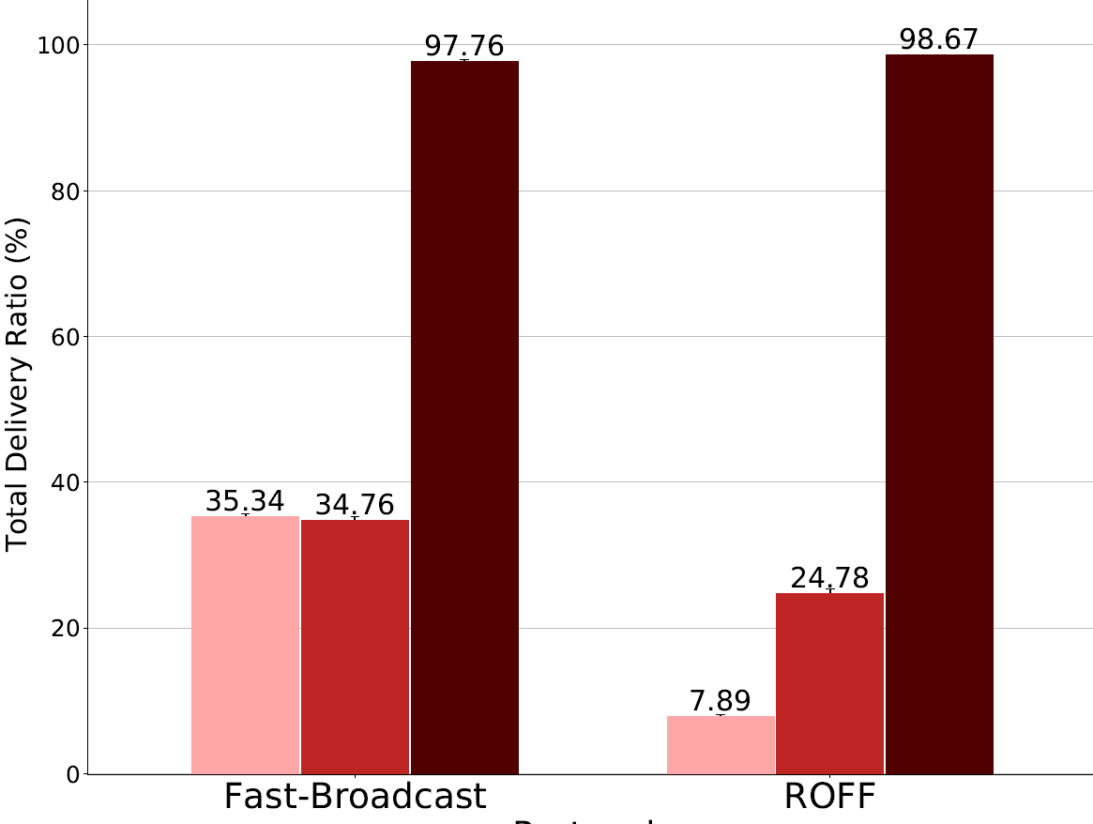
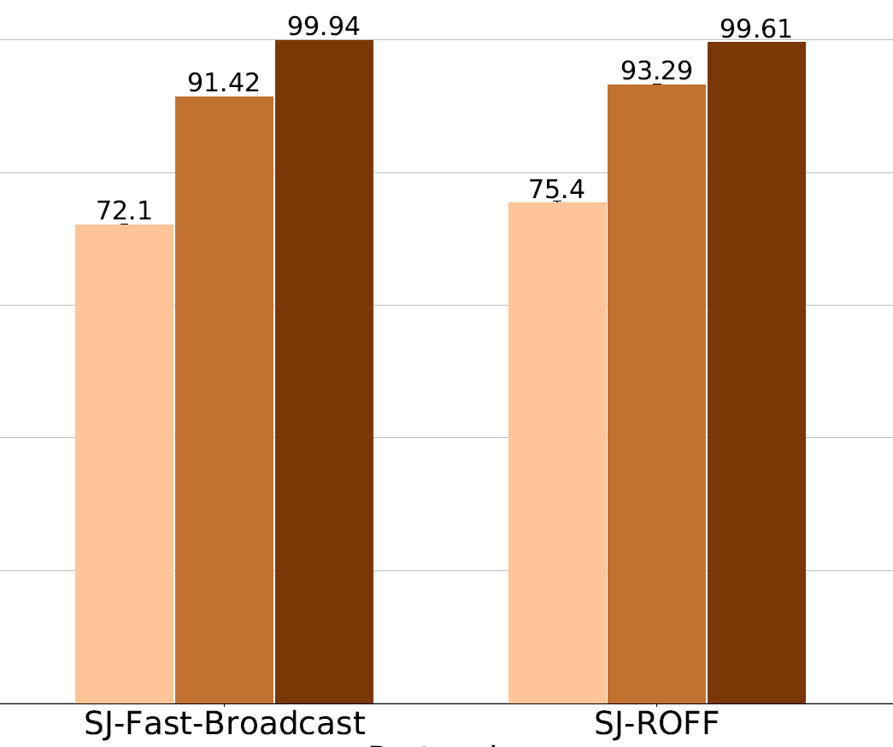



PADUA – COVERAGE ↑
Without smart junction
With smart junction
19

Slide 21
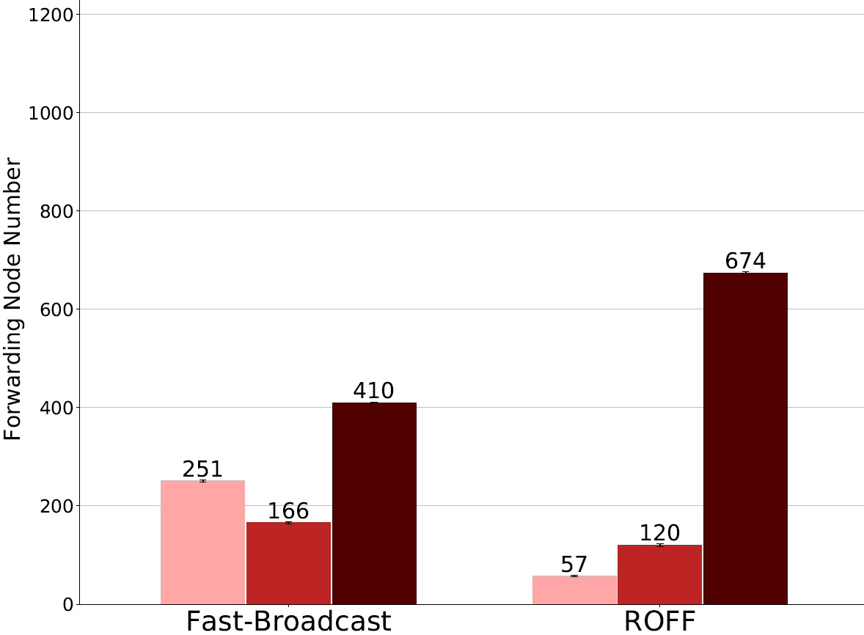
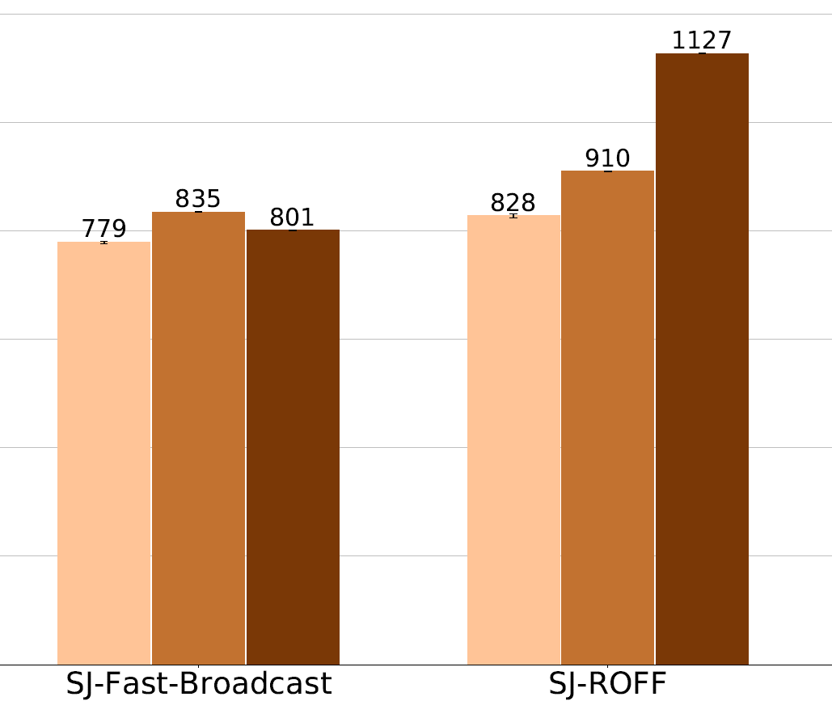
PADUA – REDUNDANCY ↓
Without smart junction
With smart junction
20

Slide 22
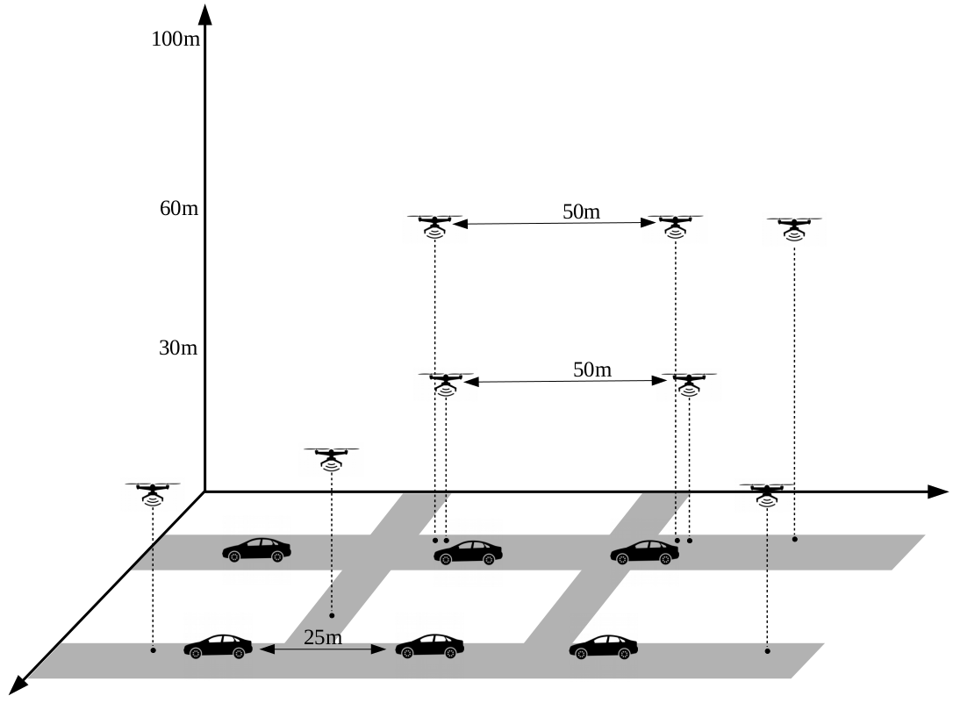
L.A. SMART CITY SCENARIO
Vehicular + drones mixed scenario
Message propagation in 3D
Different buildings configurations
No buildings
21

Slide 23
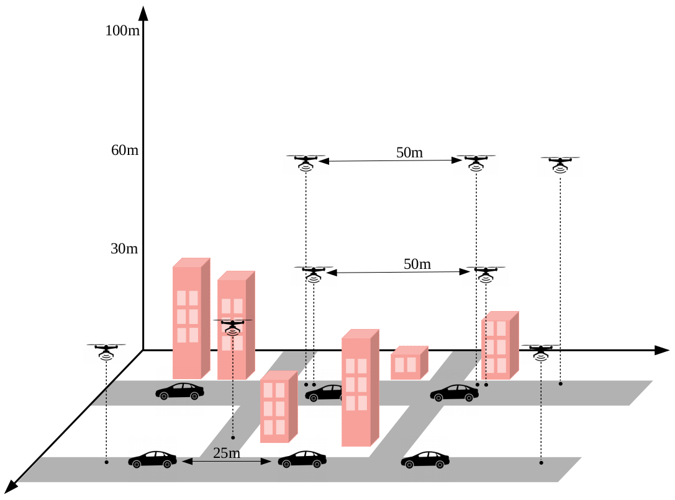
L.A. SMART CITY SCENARIO
Vehicular + drones mixed scenario
Message propagation in 3D
Different buildings configurations
No buildings
Buildings with real heights
21

Slide 24
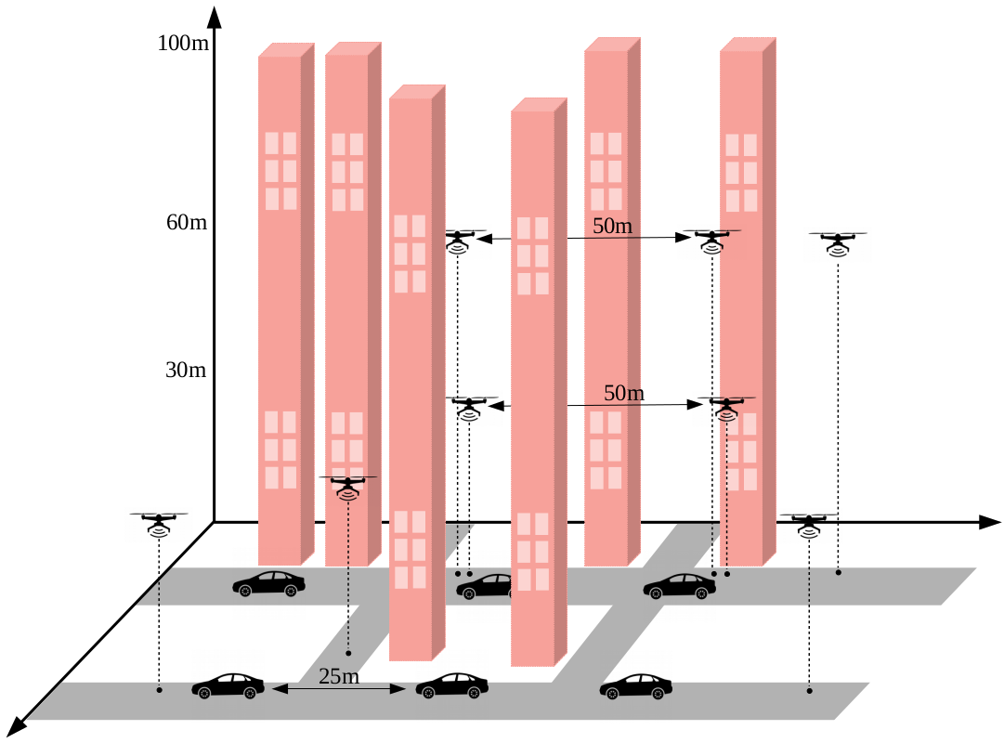
L.A. SMART CITY SCENARIO
Vehicular + drones mixed scenario
Message propagation in 3D
Different buildings configurations
No buildings
Buildings with real heights
Very tall buildings
21

Slide 25
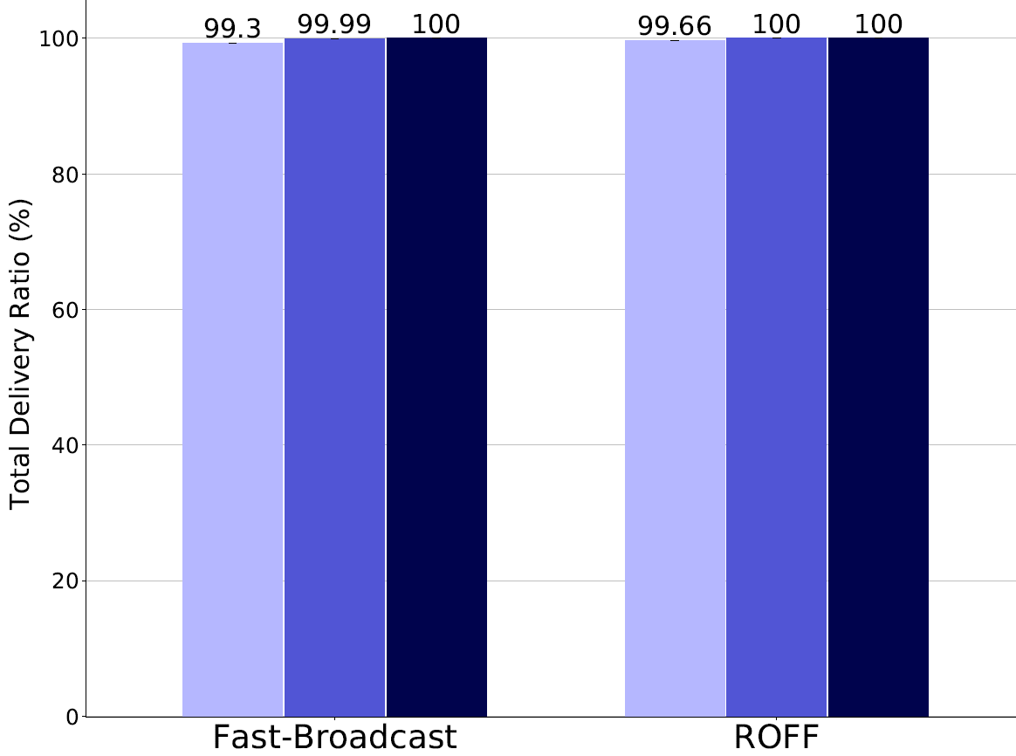
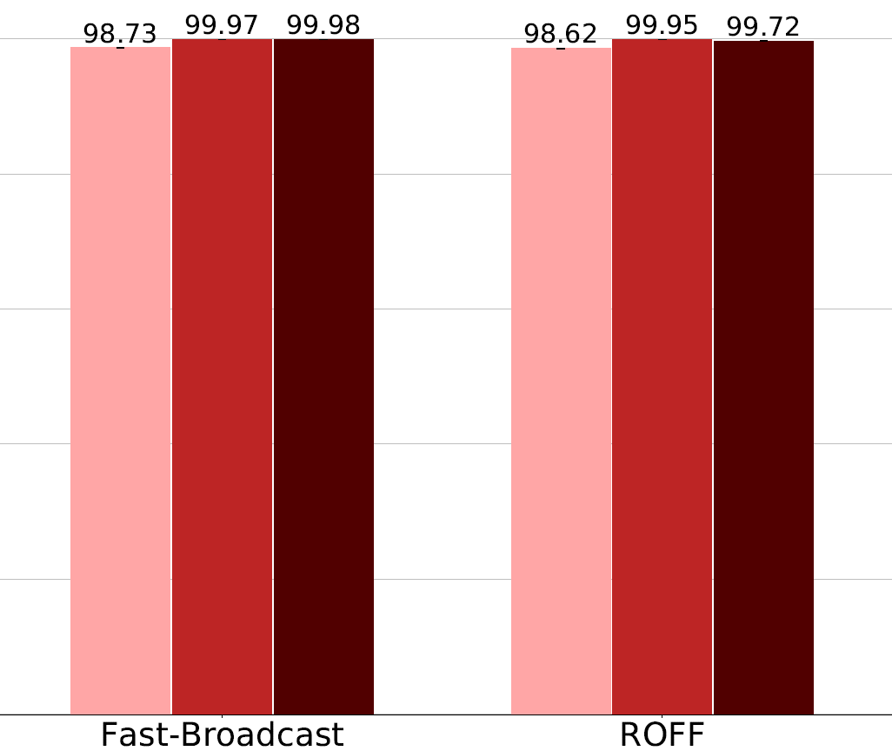
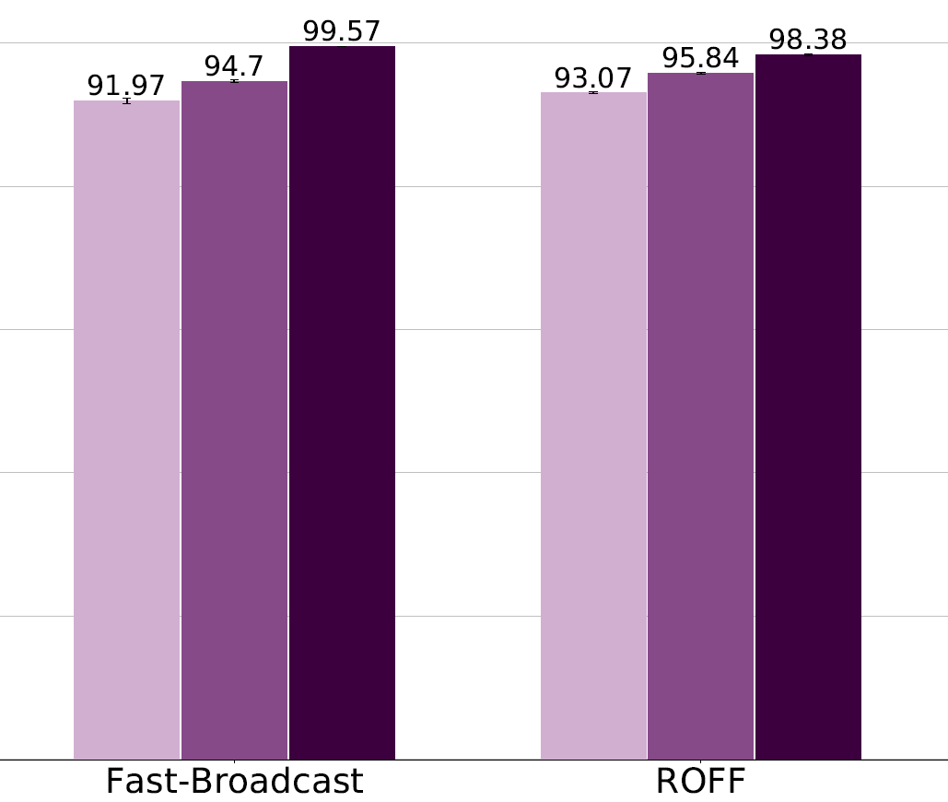



LOS ANGELES – COVERAGE ↑
Without buildings
Real height buildings
Very tall buildings
22

Slide 26
CONCLUSION
ROFF introduces a much smaller end-to-end delay than Fast-Broadcast
Greater redundancy
Determinism and collisions
High number of Hello Messages
SJ-Fast-Broadcast and SJ-ROFF improve coverage greatly
At the cost of more retransmissions
The algorithms work well even in mixed 3D scenarios
J. Gottardo, C.E. Palazzi, A. Bujari, D. Ronzani, “Message Dissemination in Urban IoV”, IEEE/ACM DS-RT 2019: The 23rd International Symposium on Distributed Simulation and Real Time Applications , Cosenza, Italy, Oct 2019 (submitted)
23

Slide 27


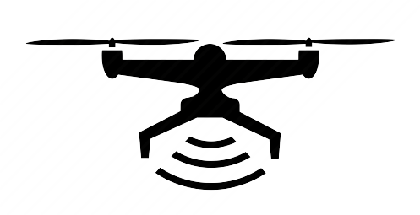
FUTURE WORK
Dynamic lower and upper bounds for Fast-Broadcast’s waiting time calculation
Based on vehicle density
Junction identification backup mode
Reliance on GPS
Compute angle between received messages to identify vehicles within junctions
Evaluation in more widespread FANETs
24

Slide 28
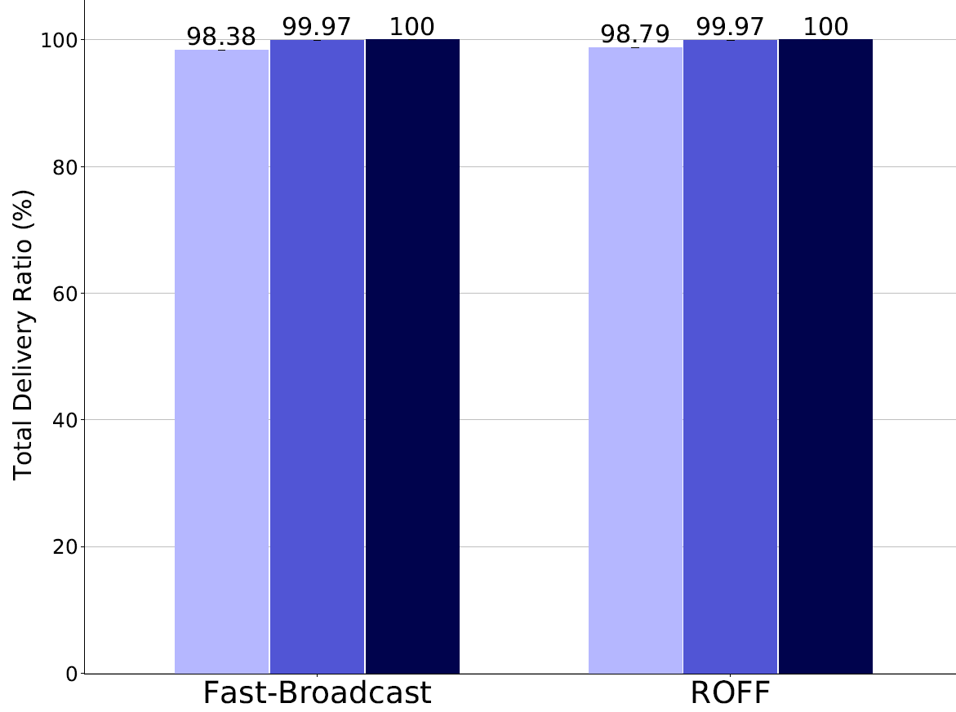
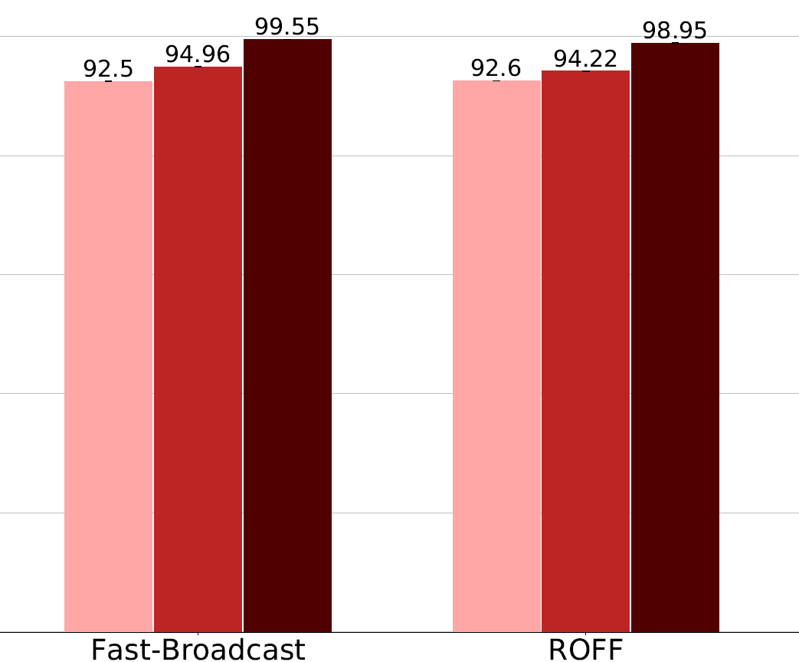
PADUA – COVERAGE ↑
Without buildings
With buildings
A.1

Slide 29
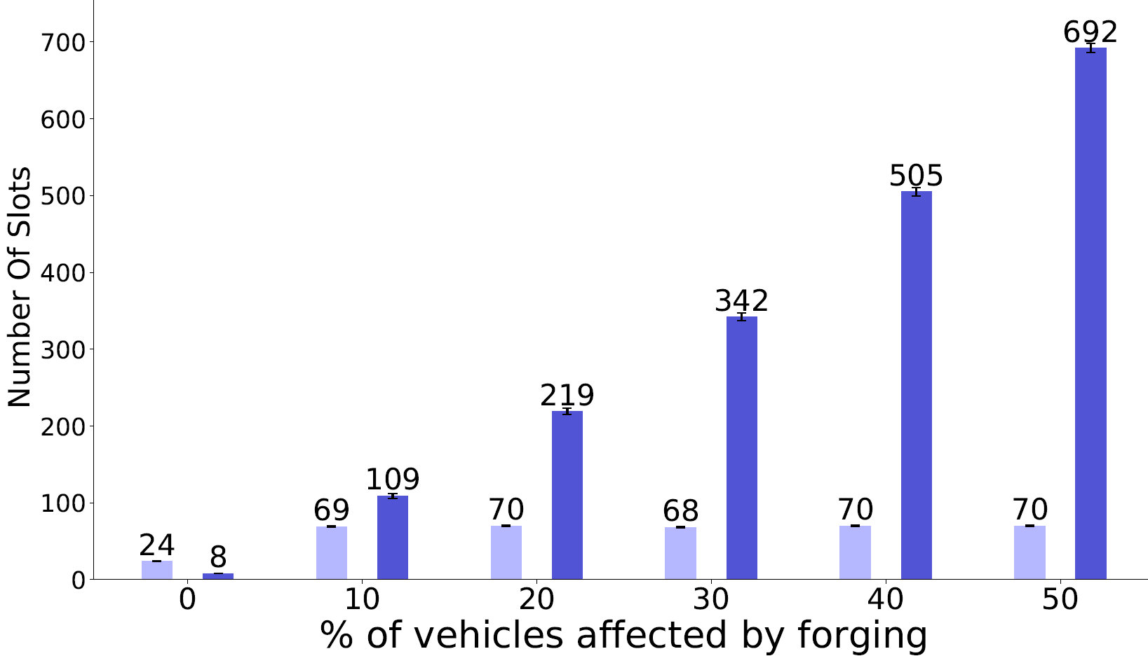

FORGING ATTACK – END TO END DELAY ↓
A.2

Slide 30


FAST-BROADCAST
Multi-hop probabilistic delay-based broadcasting protocol
Dynamic transmission range estimation
No need to know it a priori, as often assumed in other protocols
Estimation Phase:
Vehicles exchange small Hello Messages (beacons) to estimate their transmission range
1 Hello Message sent every turn within each transmission range
Broadcast Phase:
A vehicle sends an Alert Message
The neighbors receive it and participate in contention to broadcast it
The vehicles farther from sender wait less time before broadcast
Waiting time depends directly on sender-receiver distance
5

Slide 31
ROFF (RObust Fast Forwarding)
Multi-hop deterministic delay-based broadcasting protocol
Deterministically determines the farthest forwarder
Estimation Phase:
Each vehicle sends a Hello Message every BeaconInterval (e.g., 100ms)
Neighborhood discovery process
Each vehicle builds a Neighbor Table (NBT) with one entry for each neighbor
Broadcast Phase:
Waiting time differentiation based on unique forwarding priority
Vehicles estimate their own priority
High priority = low waiting time
No direct dependency on sender-receiver distance
5

Slide 32
SIMULATIONS – SCENARIOS AND METRICS
}
Several scenarios of increasing complexity
Metrics:
Total delivery ratio
Total delivery ratio on circumference
Number of hops
Number of slots
Forwarding node number
Scenario name | Type | Buildings | Drones
Platoon | 1D
Grid | 2D
Los Angeles | 2D
Padua | 2D
Los Angeles smart city | 3D
}
Coverage
End-to-end delay
}
Redundancy
5

Slide 33
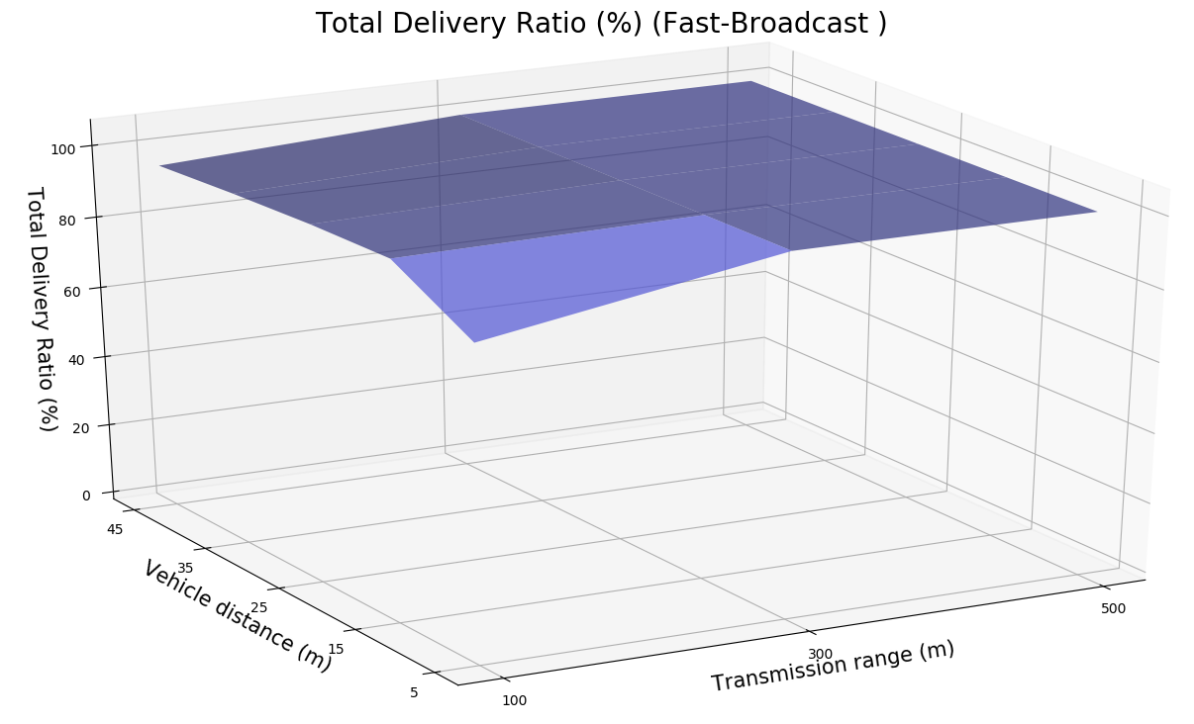
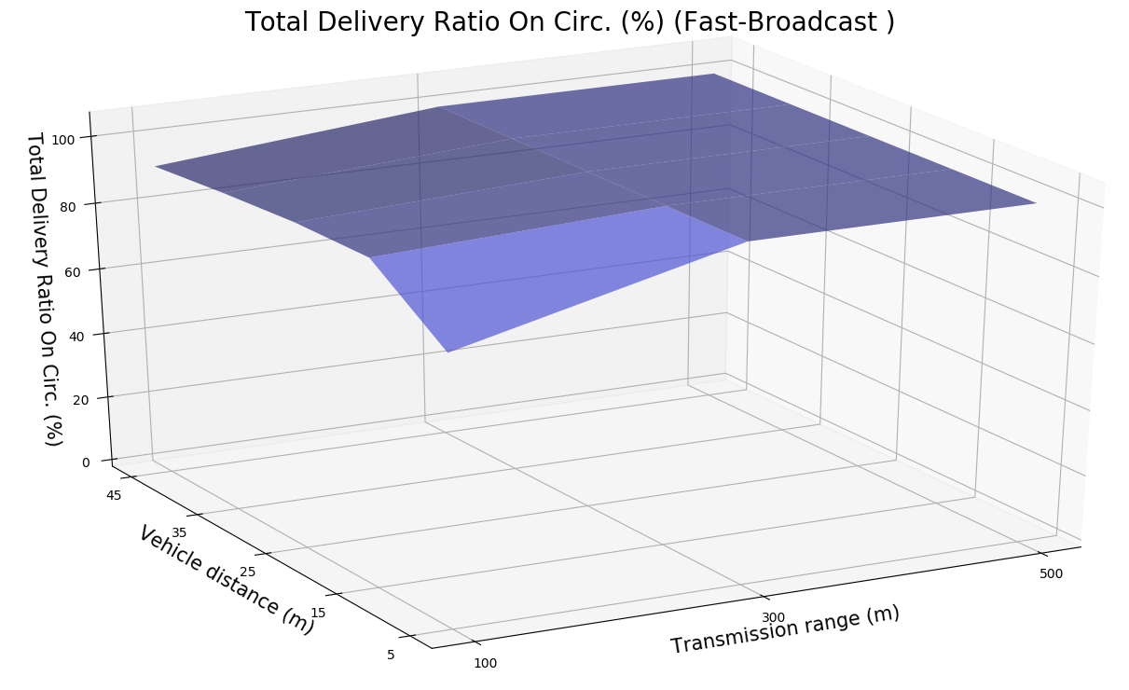
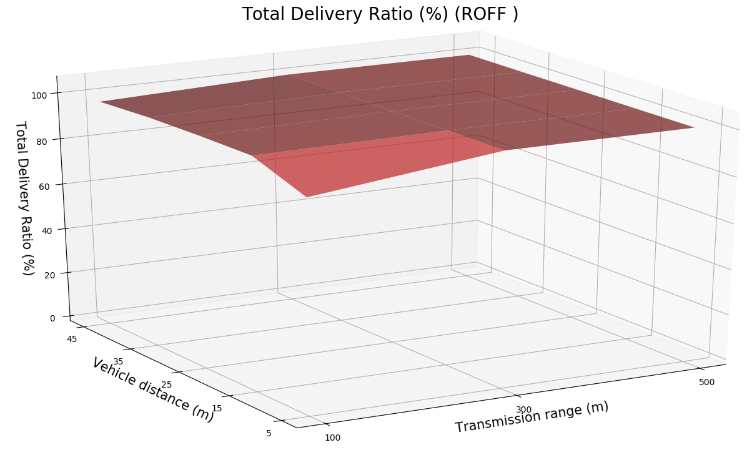
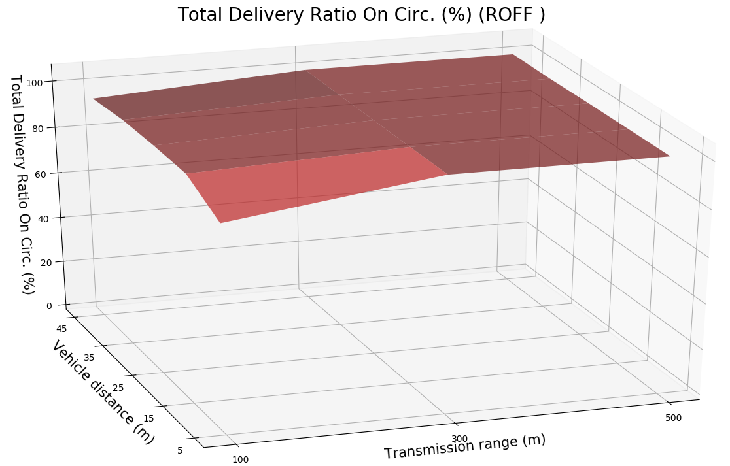
PRELIMINARY TESTS - DELIVERY RATIOS
5

Slide 34
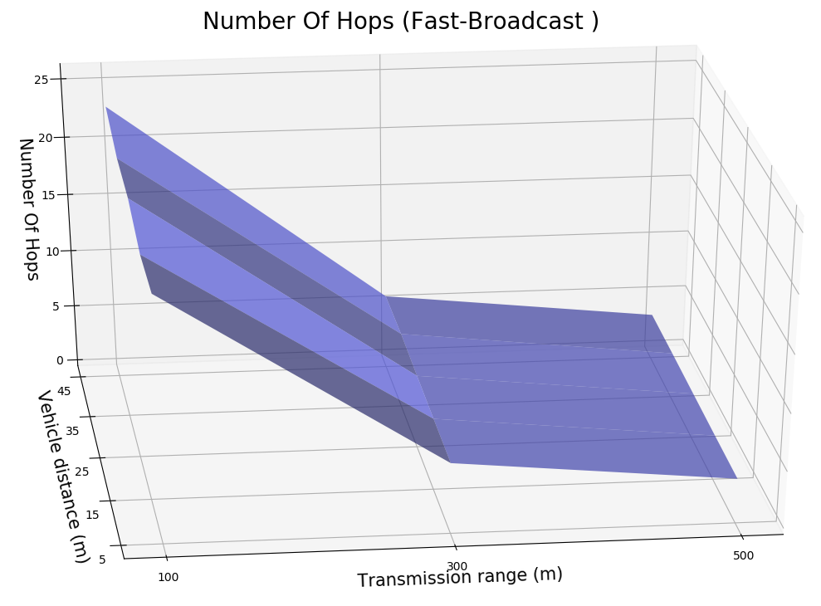
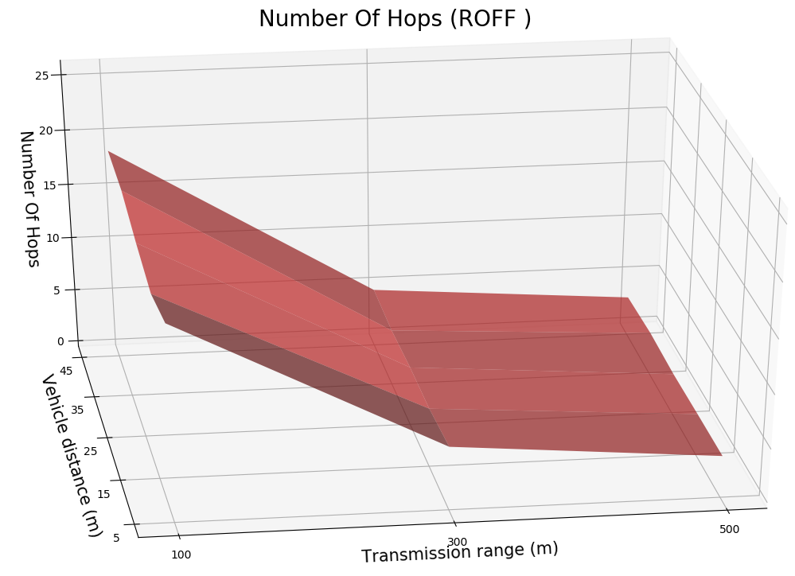
PRELIMINARY TESTS – NUMBER OF HOPS
5

Slide 35
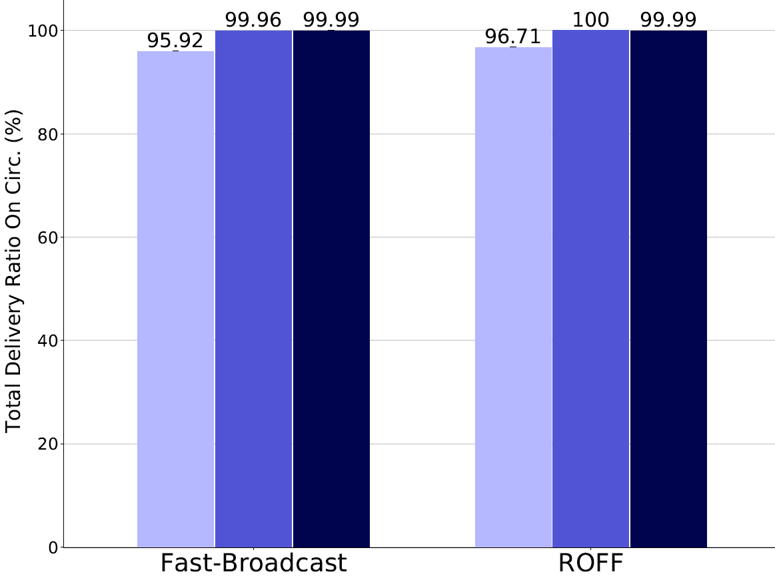
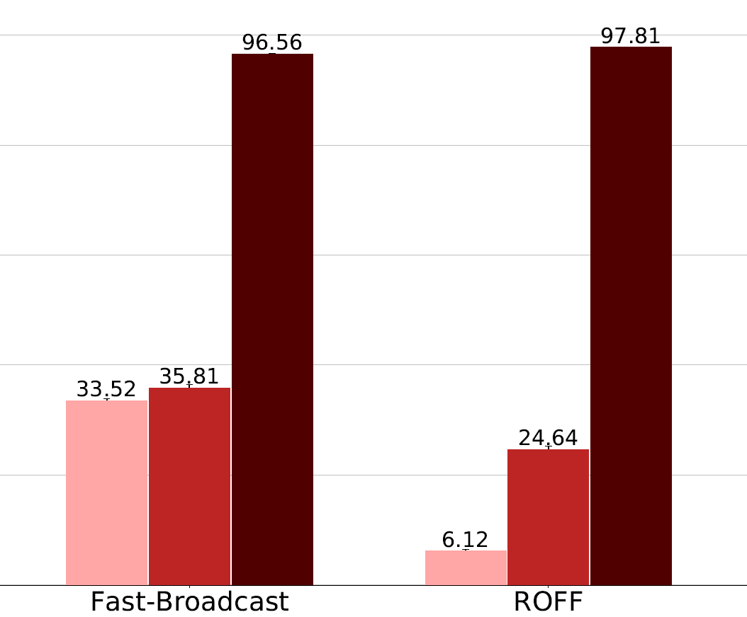
PADUA – TOTAL DELIVERY RATIO ON CIRC.
Without buildings
With buildings
5

Slide 36
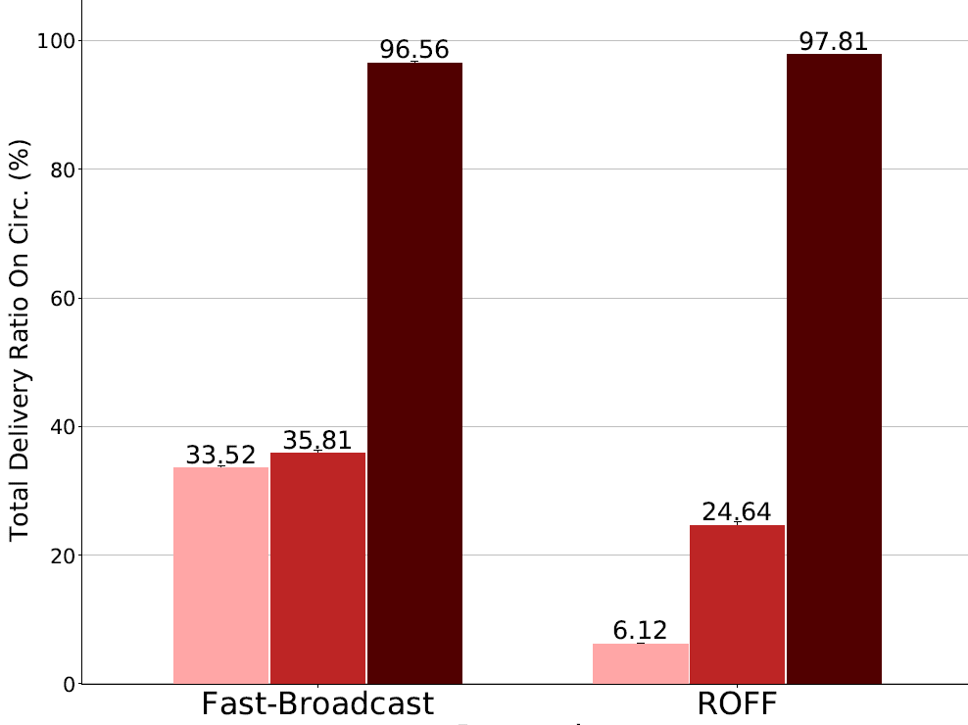
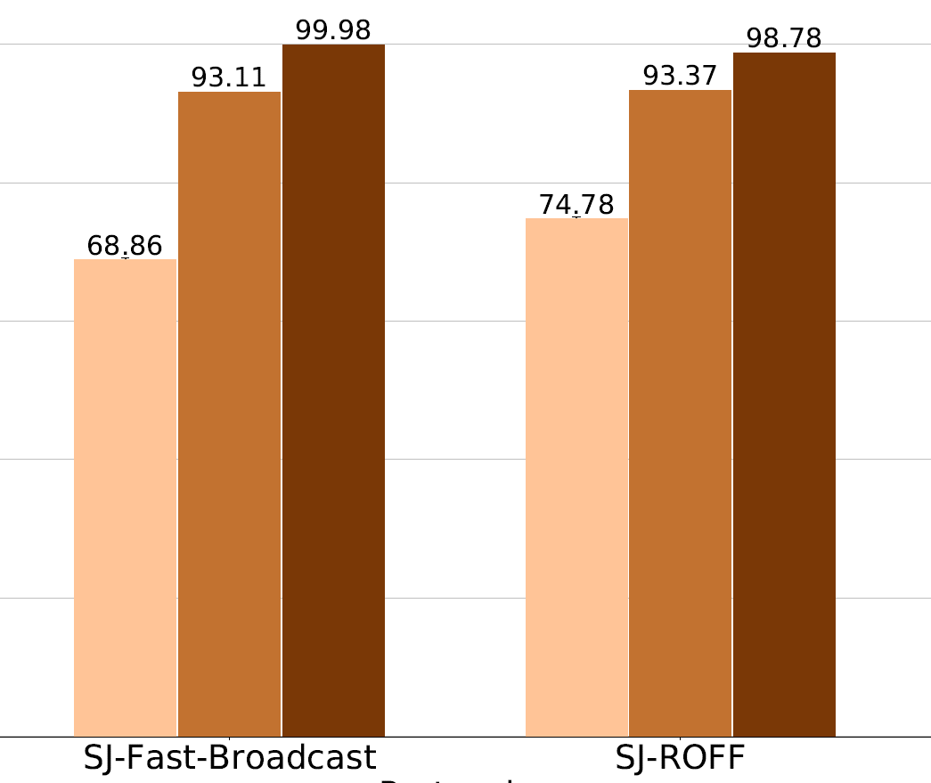
PADUA – TOTAL DELIVERY RATIO ON CIRC.
With buildings, without junctions
With buildings, with junctions
5

Slide 37
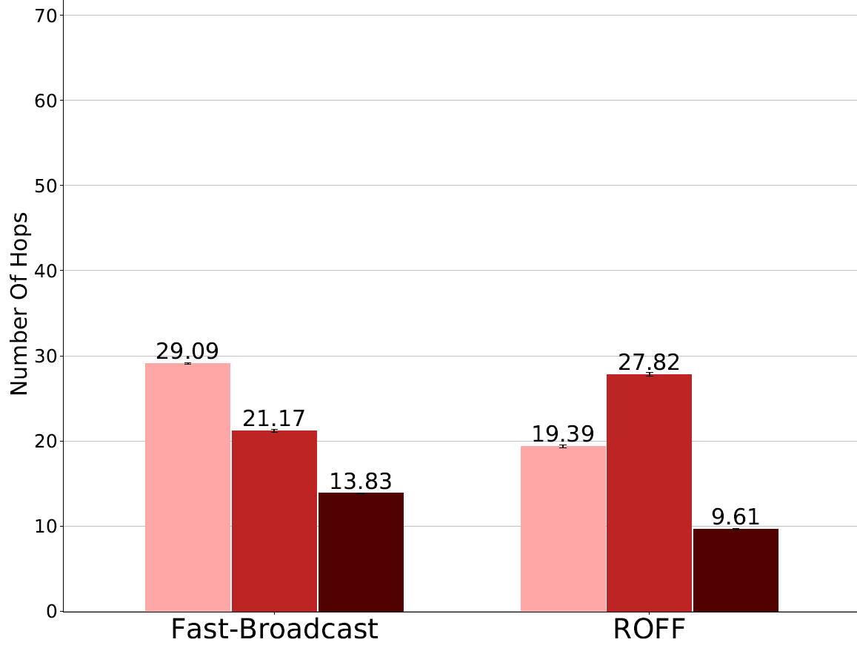
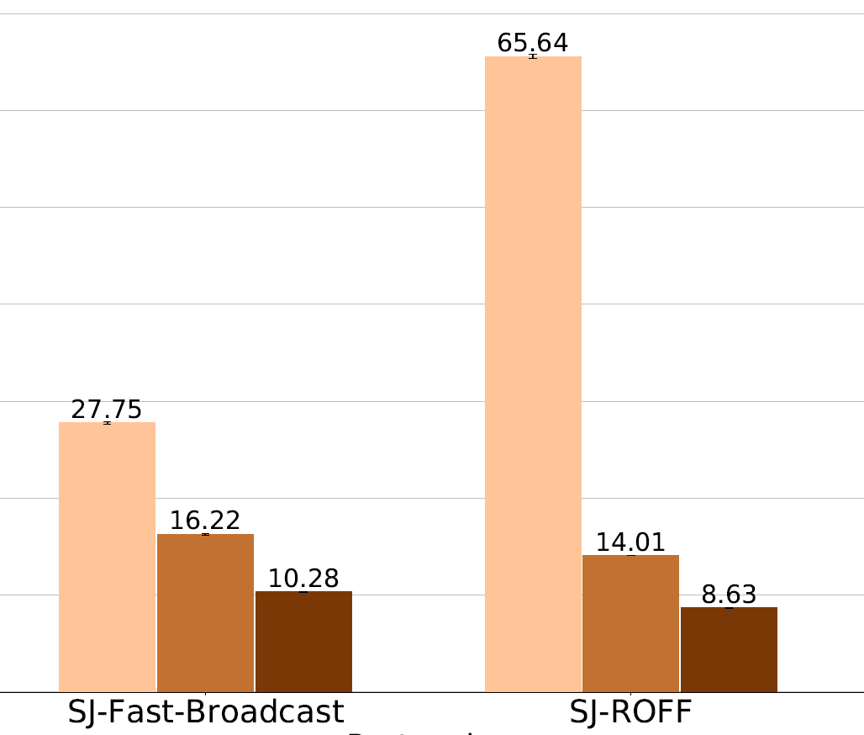
PADUA – NUMBER OF HOPS
With buildings, without junctions
With buildings, with junctions
5

Slide 38
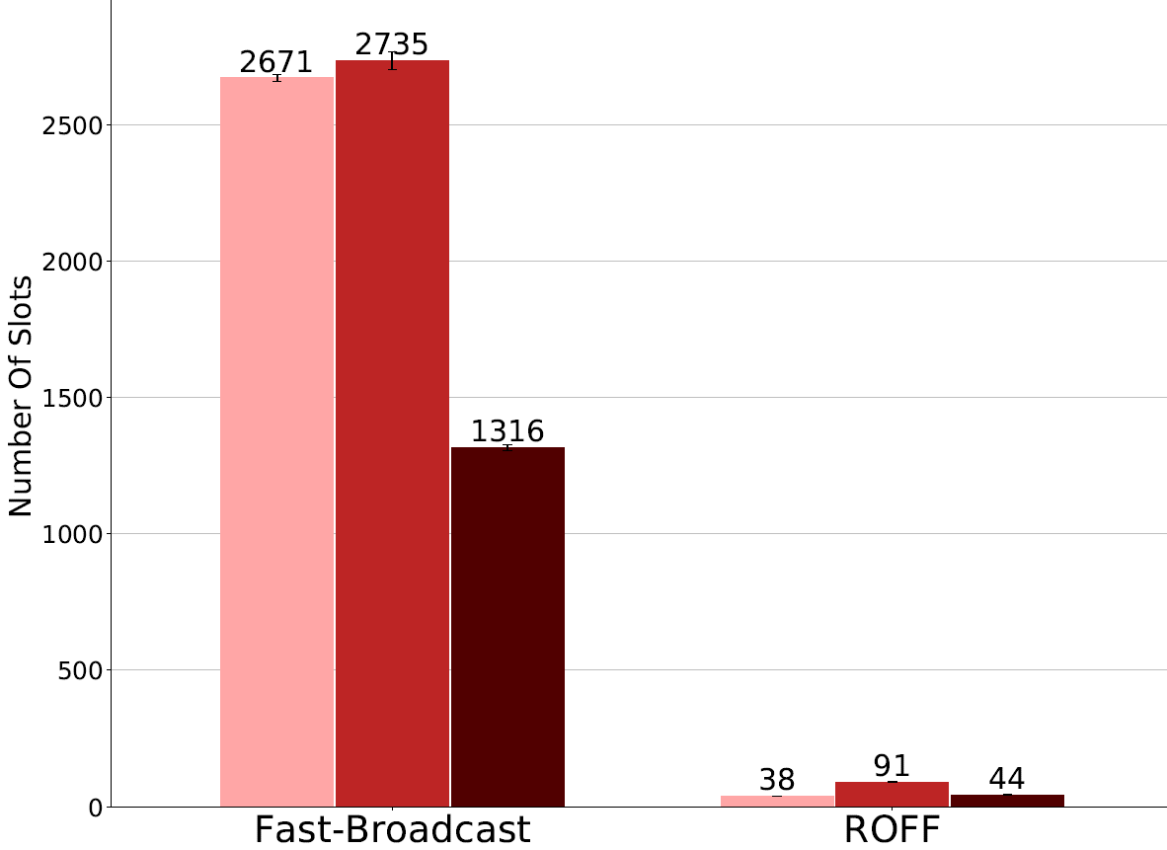
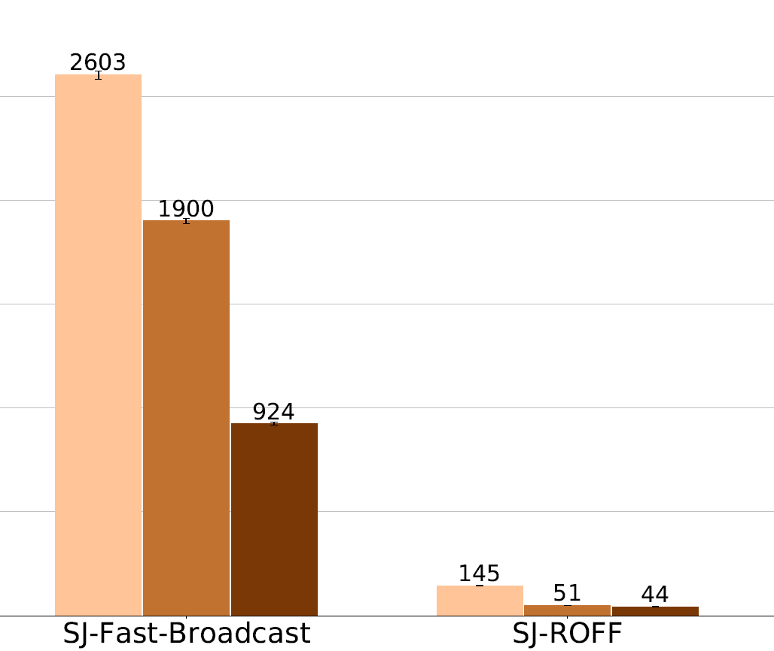
PADUA – NUMBER OF SLOTS
With buildings, without junctions
With buildings, with junctions
5

